Slide 1
FSTL4 and SEMA5A are associated with alcohol dependence: meta-analysis of two genome-wide association studies
Kesheng Wang, PhD
Department of Biostatistics and Epidemiology
College of Public Health
East Tennessee State University

Slide 2
Outline
Introduction
Alcohol dependence (AD)
Genetic study
Subjects and Methods
Design, genotyping and statistics
Results
Conclusions

Slide 3
What is Alcohol Dependence (AD)?
Alcoholism, also known as alcohol dependence (AD), is a disease that includes the following four symptoms:
Craving--A strong need, or urge, to drink.
Loss of control--Not being able to stop drinking once drinking has begun.
Physical dependence--Withdrawal symptoms, such as nausea, sweating, shakiness, and anxiety after stopping drinking.
Tolerance--The need to drink greater amounts of alcohol to get "high."

Slide 4
Is There a Genetic Influence of AD?
Family, twin, and adoption studies have demonstrated that genes play a major role in the development of alcohol dependence (Heath, 1995).
Heritability estimates range from 50% to 60% for both men and women (Prescott et al., 1999).
In genetics, Heritability is the proportion of phenotypic variation in a population that is attributable to genetic variation among individuals.

Slide 5
Genome-wide Association Studies (GWAS) and International HapMap Project
The prospect of GWAS was firstly proposed in 1996 (Risch & Merikangas, Science 1996)
GWAS will involve screening a subset of common genetic variation in human genome on large samples (300K-500K genetic markers)
The advances of human genome project (sequence project completed in 2000) and especially International HapMap Project (in 2005, 2007 and 2009) made these studies possible.

Slide 6

PHASE I – more than 1M common SNPs were typed (inter-marker spacing 5kb) (2005)
PHASE II – more than 3M common SNPs were typed (2007)
PHASE III – data released (2009)
  Totally, about 6,000,000 common SNPs (Minor Allele Frequency >5%) in human genome
Notes:
HM project has contributed to a great deal of these advances. Phase I of the hM is complete, phase II which had goal of quadrupling the density in 1 yrs time is also nearly complete and will be released next month.
One sentence :
Document Generality of recomb hotspots, a block like structure of LD, and low hap diversity leading to substantial correlations of SNPs with many neighbors

Slide 7
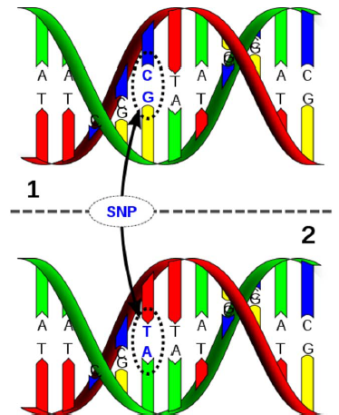
What is a SNP?
A single-nucleotide polymorphism (SNP) is a DNA sequence variation occurring when a single nucleotide — A, T, C, or G — in the genome differs between members of a species.
e.g., Two DNA fragments from 2 individuals, AAGCCTA to AAGCTTA, contain a difference in a single nucleotide.
We say there are two alleles : C & T.
One SNP has two alleles (e.g., A and a or 1 and 2) and 3 genotypes (AA, Aa and aa or 11, 12 and 22)

Slide 8
Genome-Wide Association Studies in AD
Recently, several GWAS in AD have been conducted to identify common genetic variants which affect risk of AD
1. German male sample (Treutlein et al., 2009).
2. SAGE sample (Bierut et al. 2010)
3. COGA sample (Edenberg et al. 2010)

Slide 9
Motivation of This Study
The GWAS is a powerful tool for unlocking the genetic basis of complex diseases such as AD.
Hypothesis – free (search the entire genome for associations rather than candidate areas).
A powerful tool to identify disease-related genes for many complex human disorders
However, few genetic loci were replicated in different studies. No meta-analysis of GWAS.
Objective: To conduct meta-analysis of two genome-wide association datasets to search for novel genetic variants associated with risk of AD

Slide 10
Subjects and Methods
COGA data includes 734 AD patients and 440 controls. 1M SNPs
For AD, we define 2 as affected, 1 as unaffected.
SAGE data includes 637 AD patients and 1033 controls. 1M SNPs
Australian Twin-Family Study of Alcohol Use Disorder dataset with 778 families. 370K SNPs
Each SNP has two alleles (1 and 2). Genotypes for each SNP were coded as 1/1, 1/2 and 2/2

Slide 11
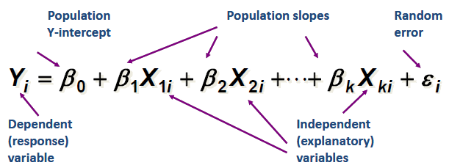
The Principle of Association for Binary Trait (AD)
In a population, for one SNP: 3 type genotypes, AA, Aa and aa.
Chi-square test based on 2 x 3 table
Simple logistic model
Multiple logistic model

Slide 12
PLINK software – GWAS analysis
Logistic model in PLINK - Odds ratio (OR) and SE (Standard error of OR) and P-values.
Meta-analysis: Fixed-effects meta-regression model in PLINK
P - Fixed-effects meta-analysis p-value
OR - Fixed-effects odds ratio (OR)
Q - p-value for Cochrane's Q statistic
Q statistics is a method widely utilized to test the assumption that all studies share a common population effect size is the homogeneity test.

Slide 13
Results of AD
We identified 81 SNPs associated with AD (p < 10⁻⁴)
Top 3 genes associated wit AD
rs930076 (p=3.86x10⁻⁶, Q=0.72) at 5p15.2 within SEMA5A gene
rs155581 (p=7.63x10⁻⁶, Q=0.97) at 5q31.1 within FSTL4
PKNOX2 at 11q24.3 with alcohol dependence (the top SNP is rs1426153 with p = 8.36x10⁻⁶, Q=0.61).

Slide 14
Replication Study
Top SNPs for three genes in Twin family study
rs950050 with p= 0.014, SEMA5A
rs407758 with p=0.0066, FSTL4
rs2509449 with p=0.0023, PKNOX2

Slide 15
Conclusions and Discussion
Identified 3 loci using meta-analysis
Replicated associations in additional family-based association study
SEMA5A is previously associated with Parkinson disease and autism
FSTL4 is previously associated with stroke and linked to schizophrenia.
PNOKX2 is previously associated with AD.

Slide 16
Importance of Genetic Effects for Clinical Practice
Increasingly medical interventions target specific genes
  Differential treatment effects
  More effective medications, less severe side effect profile
Prevention and early detection
  Early screening and population screening
Gene and environment interplay
- gender difference
- race difference

Slide 17
Take Home Messages
AD is genetically controlled
Genetic findings open valuable possibilities for the future of medicine
  Greater understanding of biologic pathways
  Prediction of the risk
  Prevention of the diseases
  Development of new treatment

Slide 18
Acknowledgement
Dr. Xuefeng Liu (Department of Biostatistics and Epidemiology)
Dr. Qunyuan Zhang (Washington University School of Medicine, St. Louis)
Yue Pan (Ms Student)
Nagesh Aragam (DrPH student)
Min Zeng (Visiting scholar)
Kesheng Wang

