Slide 1


Community-run verbal autopsies followed by local action planning decreases maternal and child deaths in rural Bangladesh
Abdur Razzaqul Alam, MBBS MPH,
Selina Amin, MBBS MPH,
SM Shahidullah, MBBS DIH MPH
Plan Bangladesh
Promising Futures, Community by Community

Slide 2
Presenter Disclosure
Abdur Razzaqul Alam
The following personal financial relationships with commercial interests relevant to this presentation existed during the past 12 months:
No relationships to disclose

Slide 3
Outline
Introducing Plan Bangladesh
Maternal and child health situation of Bangladesh
Project intervention and Verbal Autopsy (VA)
Objectives and process of VA
Finding of VA
Case study
Social impact of VA
Learning
Conclusion

Slide 4
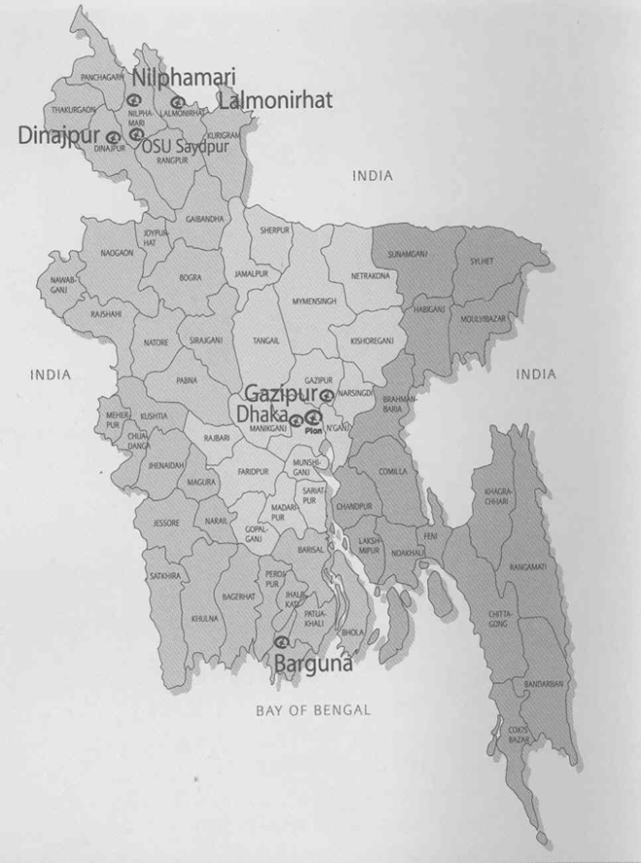
Plan Bangladesh
Working since 1994
Program unit-Five (Lalmonirhat, Nilphamari, Dinajpur, Gazipur, Dhaka) and Borguna project offices
Program approach: Child-Centered Community Development approach
Core program:
  Quality primary education program
  Community managed health care program
  Protecting vulnerable children program
  Disaster Risk Management Program

Slide 5
Maternal and child health situation in Bangladesh
Total population 162 million (Asia’s fifth and the world’s eighth most populous country)
Four and more antenatal care visits 21%
Mother and newborn receiving post-partum care 16.5%
Maternal mortality ratio – 194* per 100,000 live births
Infant mortality rate – 52 per 1000 live births
Under 5 mortality rate – 65 per 1000 live births
Neonatal mortality rate – 37 per 1000 live births
Source:*BMMS-2010 and BDHS-2007

Slide 6
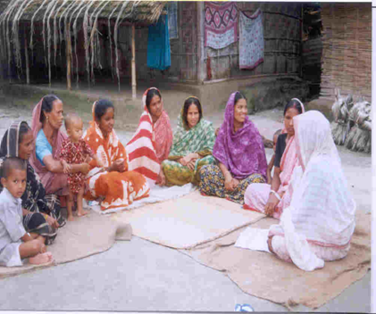
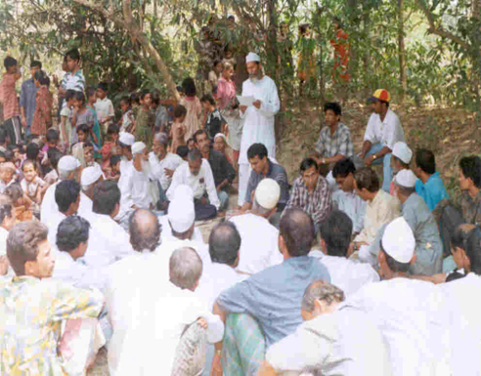
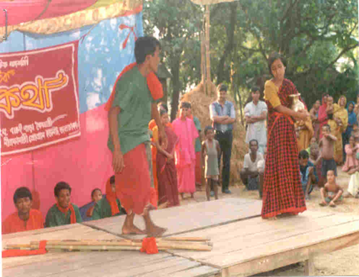



Project interventions and Verbal Autopsy
Courtyard session
Mother peer education
Household visit
Children drama
Video show
Issue-based nationals and international days observation
Verbal Autopsy (VA)

Slide 7
Objectives of Verbal Autopsy
Exploring social cause
Highlighting preventative measures
Creating social movement for avoiding recurrence of unwanted incidences (i.e., deaths).
Notes:
VA is done with a view to exploring the social causes of unwanted incidence of the community. Through this session social movement is also created to prevent such incidence in future.

Slide 8
Process of Verbal Autopsy
Obtaining verbal consent from the deceased family
Participants: Family members, adjacent neighbors, representatives of community-based organizations (CBOs), government representatives, and area project staff.
Notes:
VA session is usually done in the courtyard of the deceased family and care giver of the deceased, other family members, neighbors of family , community leaders are presents in the session. VA session usually took place with in 12-15 days of the incidence with the cosset of deceased family .

Slide 9
Process of VA..cont.
Facilitating the discussion session:
  Selecting a chairperson for the session
  Upholding cultural and religious values
  Creating an environment for the caregiver to speak in his/her own language about what happened to the deceased
Wrap-up the session by chairperson
Conclude the session with a prayer for the departed soul.

Slide 10
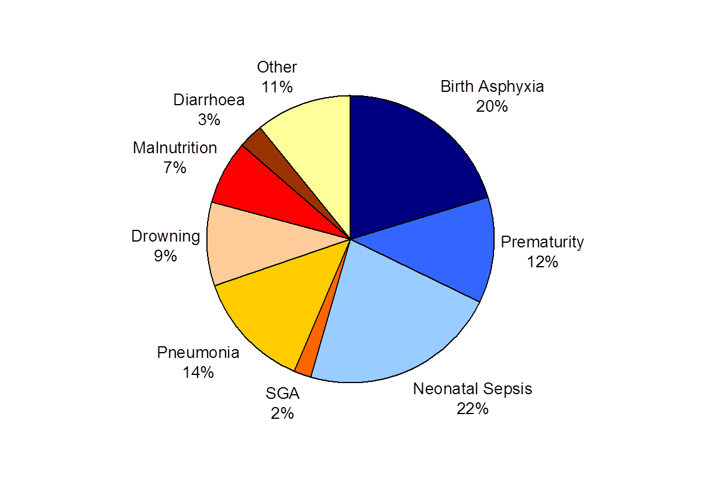
Verbal Autopsy:
Under 5 years child death
(2007-2008) n=554
Source: Plan-LAMB health project

Slide 11
Verbal Autopsies:
Maternal Death (2006-2010) n=83
Source: Plan-LAMB health project

Slide 12
Case Study:
Rima’s death was a learning tool for the community
Rima, aged 2 years has passed away before reaching her full
potentials. According to Rima’s parents she was fine till February 2007. On the morning of February 18, 2007 she was attacked with diarrhea. Through out the day she passed stool about 8-9 times. She was reluctant to eat anything. Her father was not at home that day. Her mother fed her Suji (cereals) which she vomited. On inquiry by the Program Officer it was found that the oral rehydration solution (ORS) preparation technique by the family was not correct. Her father returned in the evening and took her to a homeopathic Doctor, although the health center was nearer their house.

Slide 13
Immediate initiatives for the community
A girl volunteered to demonstrate the technique of preparing ORS.
A boy showed hand washing technique with soap after defecation and explained relationship between hand washing, nail trimming and diarrhea.
Project officer demonstrated the danger signs of diarrhea.

Slide 14
Views from Participants
Opinion of mother/family members after VA session
“We could prevent the death through following the advice of community health workers.”
“Everyone should know the correct techniques to prepare ORS.”
Opinion of CBO members after VA session
“We should all know the danger sign of diarrhea.”
“Every family should have sanitary latrine.”

Slide 15
Social and programmatic impact of Verbal Autopsy
Community people became aware of their roles and responsibilities and the importance of individual social responsibility.
Duty bearers and right holders became responsive.
Community movement evolved in a coordinated way.
Program strategic gaps were identified and were used to revisit the program with specific strategic interventions.

Slide 16
Learning
Verbal autopsy is a participatory awareness raising tool that gives a clear understanding about the specific roles and responsibilities of each community member and project staff to prevent maternal and child death.
No significant additional budget is required for this intervention.

Slide 17
Conclusion
Verbal Autopsy is a community responsive awareness raising tool that attracts the community to participate actively in awareness raising sessions
Plan Bangladesh is currently advocating and lobbying with a national-level programmer to incorporate Verbal Autopsy as a awareness raising tool in the national program along with the other tools.

Slide 18
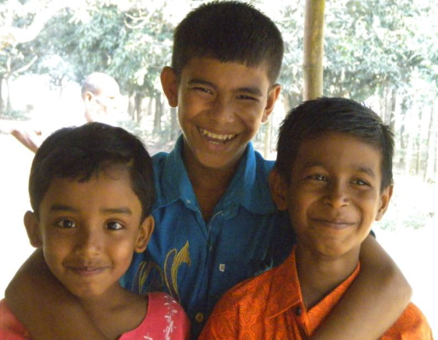
Thank you!
razzaqul.alam@plan-international.org
Mobile: +88-01715-008822
Skype: razzaqul
Promising Futures, Community by Community

