Slide 1
The Terminology of DSM-5
Substance Disorders
What’s in a name?
Wilson M. Compton, M.D., M.P.E.
National Institute on Drug Abuse
On Behalf of the DSM-5 Substance Related Disorders Work Group Terminology Subcommittee

Slide 2
Presenter Disclosures
Wilson M. Compton, M.D.
The following personal financial relationships with commercial interests relevant to this presentation existed during the past 12 months:
None. No relationships to disclose.

Slide 3
Terminology of DSM-5 Substance Disorders
Goals for Talk:
Provide information, and
Obtain feedback

Slide 4
Questions:
In general, what terminology should DSM-5 use for this area of psychopathology?
What should the chapter be named?
What should the primary disorders be named?

Slide 5
DSM III, III-R and IV
Chapter Heading:
Substance Use Disorders / Substance Related Disorders
Primary Disorders:
Abuse
Dependence

Slide 6
Terminology Subcommittee Members:
Marc Auriacombe, M.D.
Alan J. Budney, Ph.D.
Wilson M. Compton, M.D.
Thomas J. Crowley, M.D.
Bridget F. Grant, Ph.D., Ph.D.
Deborah S. Hasin, Ph.D.
Walter Ling, M.D.
Charles P. O’Brien, M.D.
Nancy Petry, Ph.D.

Slide 7
Background Assumptions:
Abuse/Dependence dichotomy eliminated in favor of a unified set of criteria.
Gambling disorders moved to this section.
Substance induced disorders (i.e. intoxication, withdrawal, mental illnesses) included.

Slide 8
Examples of Naming in the
Alcohol and Drug Field
Abuse
Addiction
Alcoholism
Chemical
Dependence
Dependence Syndrome
Dipsomania
Drug
Habituation
Harmful Use
Inebriety
Misuse
Narcomania
Psychoactive Substance
Pseudoaddiction
Substance

Slide 9
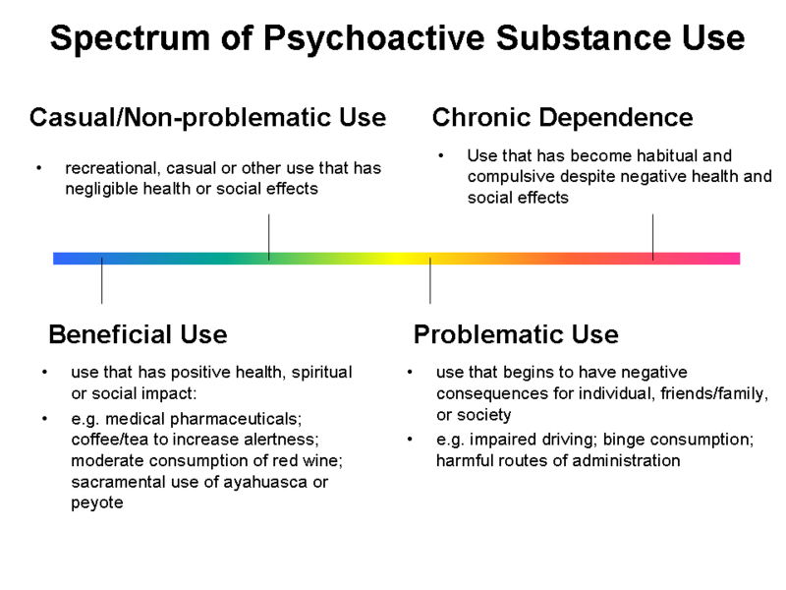

Slide 10
Examples of Naming in the Alcohol and Drug Field
“The definition of addiction gained some acceptance, but confusion in the use of the terms addiction and habituation and misuse of the former continued….The component in common appears to be dependence, whether psychic or physical or both…. The Expert Committee recommends substitution of the term 'drug dependence' for the terms 'drug addiction' and 'drug habituation'.”
WHO Expert Committee 1964

Slide 11
Kelly and Westerhoff: “Abuse” More Stigmatizing Than “Use Disorder”
Vignette study of 516 clinicians showed lower perpetrator-punishment responses when faced with the substance use disorder label compared to the substance abuser label.
p = .02
e.g. “His problem is caused by a reckless lifestyle” (.69)
“Mr. Williams is responsible for causing his problem” (.59)
“He should be given some kind of jail sentence to serve as a wake-up call” (.53)
“His problem is caused by poor choices that he made” (.51)
Kelly JF, Westerhoff CM. International J Drug Policy 2009

Slide 12
Preliminary Workgroup Recommendations:
Chapter Heading
Addictions and Related Disorders
or
Substance, Gambling and Related Disorders
(Minimal support for : Appetitive Behavior and Related Disorders )

Slide 13
Preliminary Workgroup Recommendations:
Disorder Heading
Substance Use Disorder (as in alcohol use disorder, amphetamine use disorder, etc.)
Minimal support for : Addiction (i.e. alcohol addiction, amphetamine addiction, etc.) and Substance Dependence (i.e. alcohol dependence, amphetamine dependence, etc.)

Slide 14
DSM-5 Development Website for Comments 10 February 2010 to 20 April 2010
Substance –Related Disorders
Total comments: 389 (including a few duplicates)
Comments on terminology: ~57*
Use Disorder: ~19
Chapter Heading: ~26
Other: ~12
* Note significant overlap with comments on pathological gambling, elimination of abuse/dependence dichotomy, and severity. Also, includes a few duplicates.

Slide 15
“Use Disorder” Disorder Terminology Comment Examples 2010
“I love this idea. I think it provides less of a stigma.”
“I like the idea of removing the term dependence, often misunderstood and frightening to Clients.”
“We are pleased that the term ‘abuse’…will no longer be a diagnosis…”
“It is gratifying that the work group has jettisoned the concept of ‘drug abuse’…”
“I fully support ceasing the use of the term dependence”

Slide 16
“Use Disorder” Disorder Terminology Comment Examples 2010
“…we miss the inclusion of a more ‘generic’ diagnosis, that we coined ‘reward-drive dysregulation syndrome’.”
“Would you consider a change of the terminology to Alcohol Misuse Disorder?”
“While opioid use disorder is some improvement over the prior term of opioid dependence, you still fail to describe the condition for what it really is - opioid addiction.”
“I am not very keen on the use of the term Substance Use Disorder.”

Slide 17
“Use Disorder” Disorder Terminology Comment Examples 2010
“…the term ‘substance use disorder’ belittles the severity of addiction.”
“Please come up with something that is linguistically less cumbersome than ‘substance use disorder’.”

Slide 18
“Addiction and Related Disorders” Chapter Comment Examples 2010
“This is a desirable change.” “Great change!”
“… I like the entire concept of "Addiction and Related Disorders," as many beyond the traditionally … ‘ingested’ addictions bring clients to treatment…”
“…this change is befitting with the extent of research that demonstrates the properties of addiction are similar when comparing substances and activities.”

Slide 19
“Addiction and Related Disorders” Chapter Comment Examples 2010
“I respectfully disagree.”
“I do not support reclassifying substance-related disorders to Addiction and Related Disorders.”
“…addiction has not been clearly defined…”
“I am opposed…”

Slide 20
Other Comment Examples 2010
“Change the name for ‘nicotine dependence’ to ‘tobacco dependence’…”
“Why not have a single substance use disorder diagnosis, with the specific drug(s) as specifiers? This would be much simpler and would not suggest that the disorders have distinct diagnostic criteria which they do not.”

Slide 21
DSM-5 Development Website for Comments 1 May 2011 to 15 July 2011
Substance –Related Disorders
Total comments: 78 (including a few duplicates)
Comments on terminology: ~22*
Use Disorder: ~19
Chapter Heading: ~26
Other: ~12
* Note significant overlap with comments on pathological gambling, elimination of abuse/dependence dichotomy, and severity. Also, includes a few duplicates.

Slide 22
Comment Examples 2011
“Substance "Use" Disorder is an abomination.”
“…‘addiction’ more clearly distinguishes a maladaptive state of compulsive drug use from the expected physiologic state of physical dependence than do the terms ‘dependence’ or ‘disorder’ ”.
“I prefer substance use disorder”
“ THERE IS ONLY OBSCURITY TO BE ACHIEVED BY AVOIDING THE TERM ADDICTION.”

Slide 23
Comment Examples 2011
“I agree with the proposal for a single substance use disorder diagnosis with levels of severity.”
”Including craving as a criterion is a wonderful advance.”
“…talk about the plant products, cannabis and tobacco, or talk about the addictive chemicals… So there could be Nicotine Use Disorder and Cannabinoid Use Disorder, or it could be Tobacco Disorder and Cannabis Disorder.”

Slide 24
Comment Examples 2011
“The overall title of the chapter has to be something like ‘Substance Related Disorders’ or ‘Addiction and Other Substance Related Disorders’.”
“If what they have learned to call addiction does not appear in the DSM because only "substance use disorder" is listed, then the ensuing confusion could delay in treatment seeking.”
“ ‘Substance-Related Disorders’ seems more descriptive and broader.”

Slide 25
Comment Examples 2011
“I like that there is an addiction emphasis in the name of this category and that gambling was moved here.”
“Very, very bad idea to move back to the concept of ‘addiction’ and the suggestion that compulsive behaviors are akin to substance dependence.”

Slide 26
Curren Recommendations:
CHAPTER: Substance, Gambing and Related Disorders
(Also considering Substance Use, Addictions and Related Disorders)
DISORDER: Substance Use Disorder (as in alcohol use disorder, amphetamine use disorder, etc.)

Slide 27
Next Steps
Complete Field Trials
Consider Emerging Literature on Terminology
Make Final Decisions for DSM-5

