Slide 1
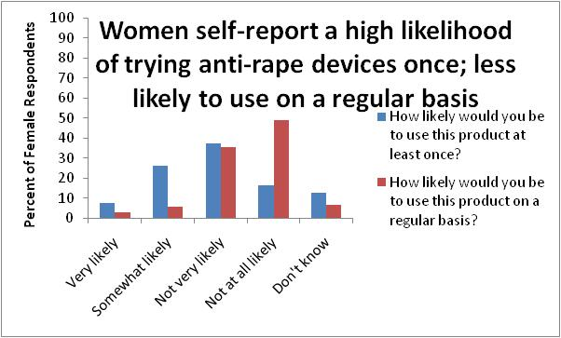
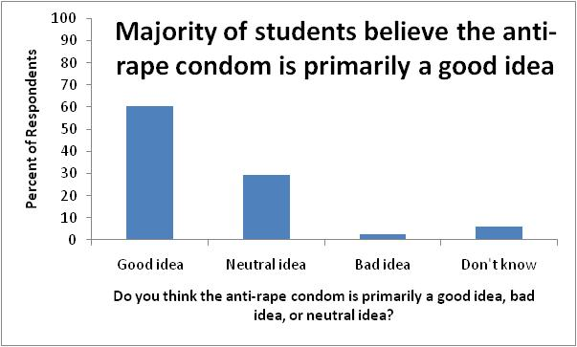

Examining South African College Students’ Attitudes Towards Gender and the Anti-Rape Condom
Cassie Chambers, MPH
Context
South Africa has the highest reported rape rates in the world, with 28% of men stating they had raped a woman or girl and 20% of men stating they had raped a woman or girl in the past year (Human Rights Watch, 2010). Given the high physical and psychological costs associated with rape—costs that may be heightened given South Africa’s high HIV prevalence—it is important to examine effective mechanisms of reducing sexual violence. The anti-rape condom, known also as Rape-Axe, is one proposed method of reducing sexual violence that has received much media attention.
Acceptability of Anti-Rape Condoms
About Rape-Axe
Perceived Concerns and Benefits Surrounding Anti-Rape Condoms
Rape-axe is designed to prevent unwanted vaginal intercourse. It is shaped like a female condom and is designed to be inserted into the vagina. The anti-rape condom differs from other condoms in that it has sharp spikes that are designed to imbed in a male’s penis upon penetration. The pain caused by these spikes is extreme, allowing a female to escape a sexually violent situation. Females can insert and remove the anti-rape condom at will.
Concern | Percent of Respondents Endorsing as Legitimate
Using it may make rapists angry and more violent | 88.51%
It will lead to an increase in anal rape | 71.62%
It will cause preventing rape to be seen as the responsibility of women | 66.89%
Women will use it inappropriately, for example during consensual sex to get back at a cheating boyfriend | 57.43%
It will cause increased support for vigilante justice | 29.05%
It will lead to increased hostility between men and women | 22.30%
It is too severe of a punishment for rapists | 6.10%
Benefit | Percent of Respondents Endorsing as Legitimate
It will serve as a deterrent to would-be rapists | 82.19%
It will stop rapists is they are attempting to rape someone | 80.82%
It will make women feel more confident going out alone at night | 75.34%
It will reduce the spread of HIV/AIDS | 74.66%
It will make it easier for police to catch rapists | 52.74%
It will make men feel more confident about their female partners going out alone at night | 52.05%
It will improve gender relations | 12.33%
This Study
This study surveyed 151 University of Cape Town students about their attitudes towards anti-rape condoms. This study was particularly interested in understanding the cultural acceptability of anti-rape condoms and how attitudes towards anti-rape condoms may be related to perceptions of gender and sexual violence. It was hypothesized that continued high rates of sexual violence may have led to a cultural shift that increasingly views women as being responsible for preventing sexual violence. This shift may lead to increased support for anti-rape condoms.
Conclusions
Overall, evidence suggests South African students perceive anti-rape condoms as having a role in preventing sexual violence, although this role is still somewhat undefined. Although the majority of students believe the overall impact of anti-rape condoms to be positive, evidence suggests students retain many serious concerns about the introduction of these devices into society. Moving forward, this research will seek to understand how perceptions about gender and attributions about responsibility for sexual violence lead to individual differences in support for anti-rape condoms.
Acknowledgments: This research was funded by a Bates Summer Fellowship from Yale University.

